Slide 1
Cuyahoga County Airport Runway 6/24 Safety Area Improvement Program OVERVIEW September 2015

Slide 2
Multi-Year Program Overview
Runway “shift” to the west
Reconstruct 1,239’ of the Runway 6 end 1,002’ of the Runway 24 end
Install new drainage & grade RSA to standards (+/- 500,000 CY of cut)
Reconstruct southern half of existing Runway 6/24
Rehabilitate northern half of existing Runway 6/24
Edge Lights – Raise and Relocate
322’ EMAS bed on Runway 6 departure end
435’ EMAS bed on Runway 24 departure end
Relocate Runway 24 approach lights
Relocate Runway 24 Glideslope antenna & PAPI

Slide 3
Why?
Non-compliant Runway Safety Area (RSA) off ends of the Runway 6/24
Runway lateral RSA grades not compliant
Ground within primary surface & Part 77 transitional surface
Inadequate pavement section
Non-complaint transverse grades on Runway (super elevated)
Non-complaint connector taxiway location (direct access from apron to runway w/o turn)

Slide 4
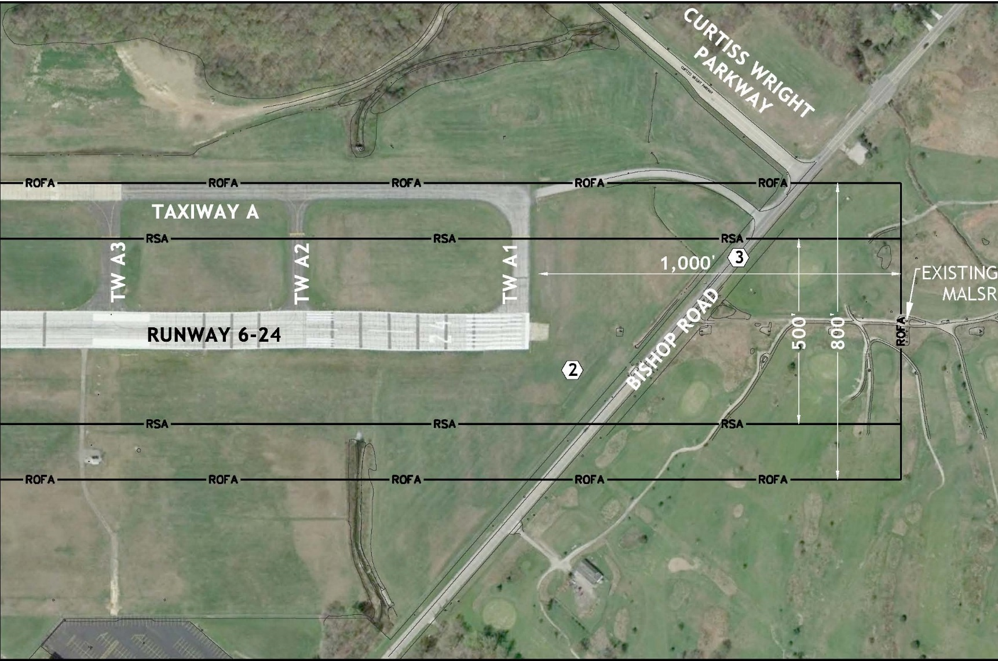
Why?

Slide 5
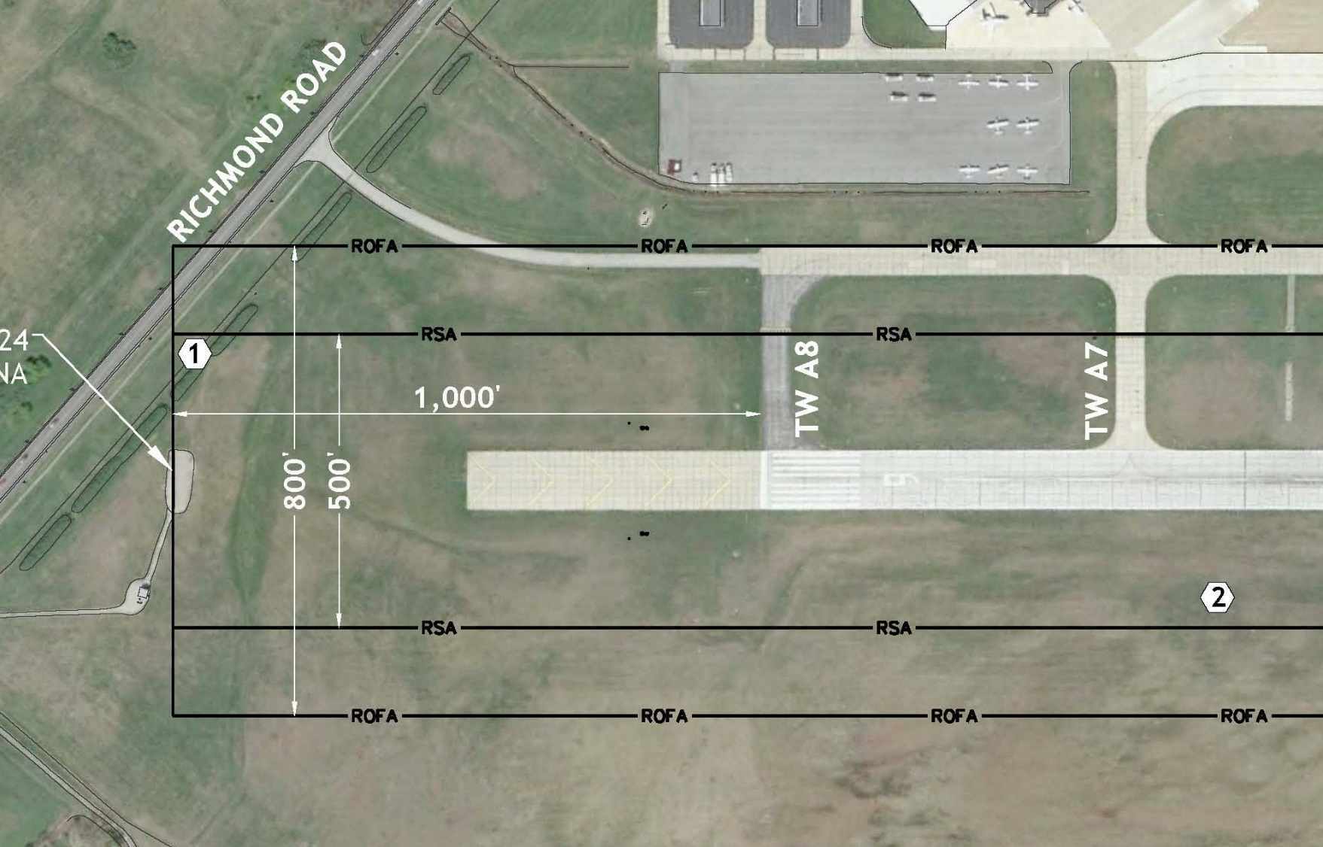
Why?

Slide 6
What are the project limitations?
FAA Funding
Timing (normally do not issue grants until September)
Discretionary Amount(s) Unknown
FY 15 is last year of the 4-year Reauthorization Bill
Can’t start on the runway ends first
Shorten existing runway
Profile issues
No work within the RSA when runway is open
FAA will not grant modifications to standards on runway transverse grades

Slide 7
Overall Phasing Schedule
Package #1 – Earthwork & Drainage - $5 M
Received Bids - June 2015
Grant Issued – September 2015
Construction – March 2016
Package #2 – Reconstruct/Rehabilitate Existing Runway 6/24 - $9.8M
Receive Bids – April 2016
Construction – August 2016 – November 2016
Package #3 – Runway 6 End Reconstruction/Shift/EMAS Installation - $10M
Construction – March 2017
Package #4 – Runway 24 End Reconstruction/Shift/EMAS Installation - $15M
Construction – March 2018

Slide 8
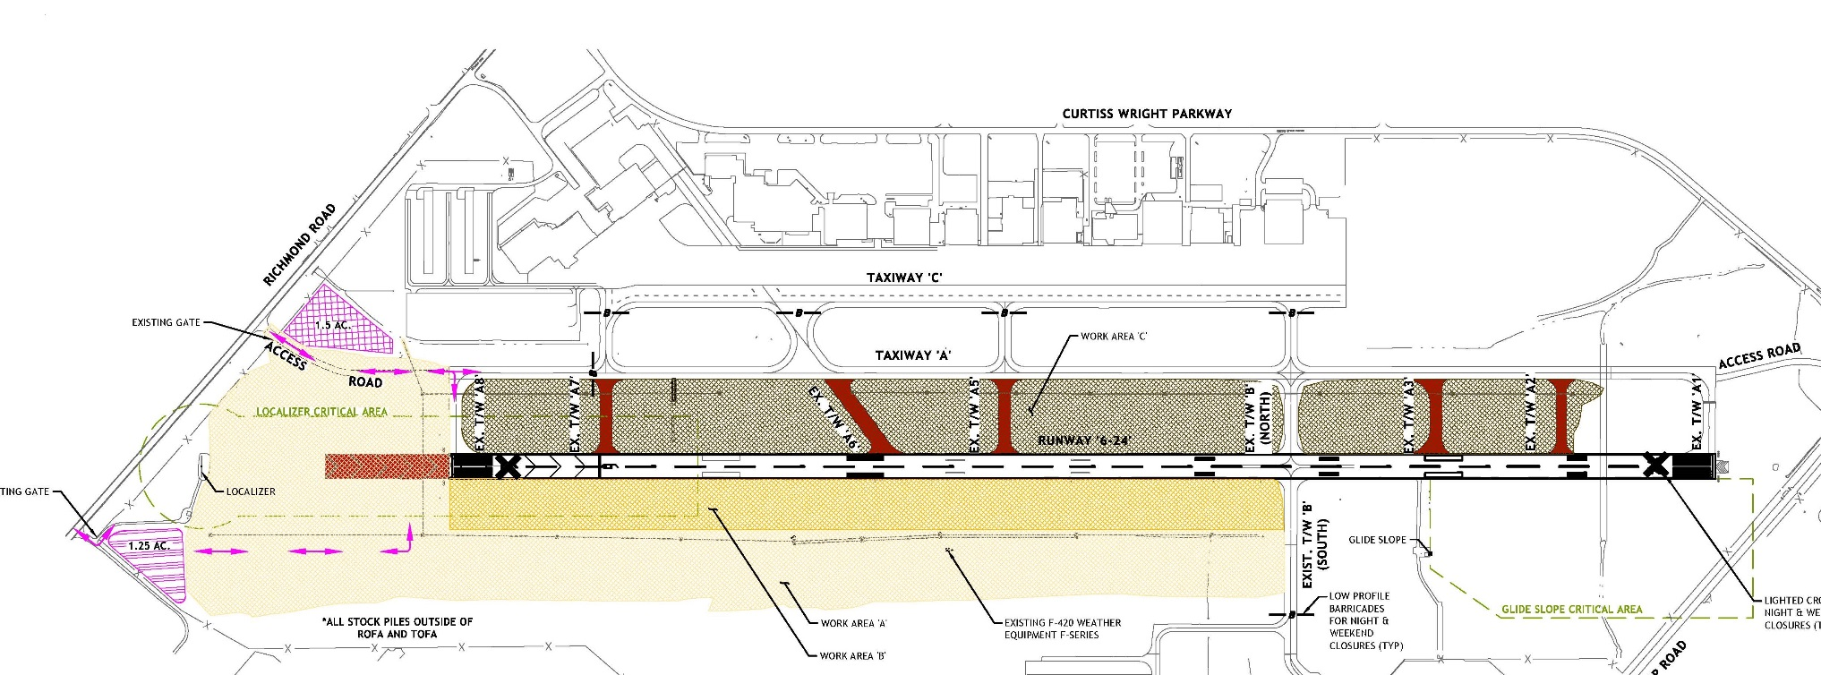
Package #1 – Earthwork & Drainage
\

Slide 9
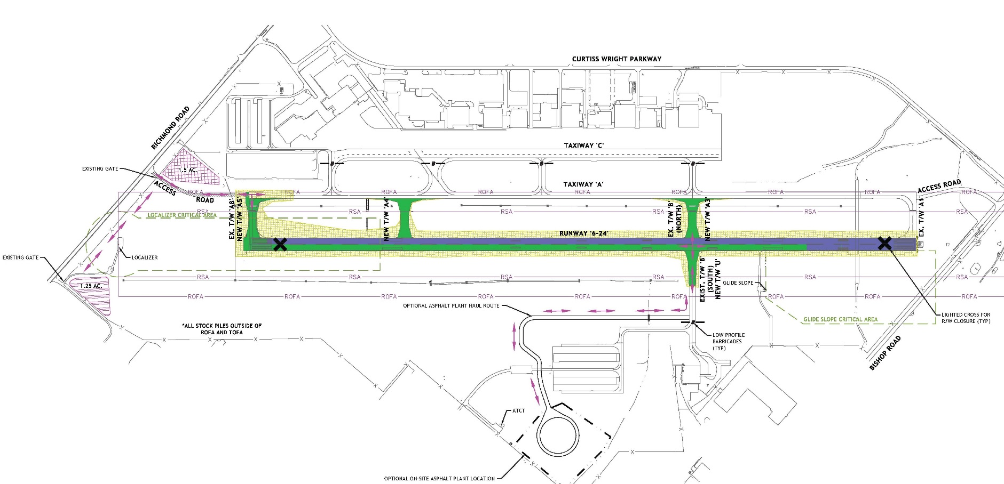
Package #2 – Existing Runway 6/24 Rehabilitation/Reconstruction

Slide 10
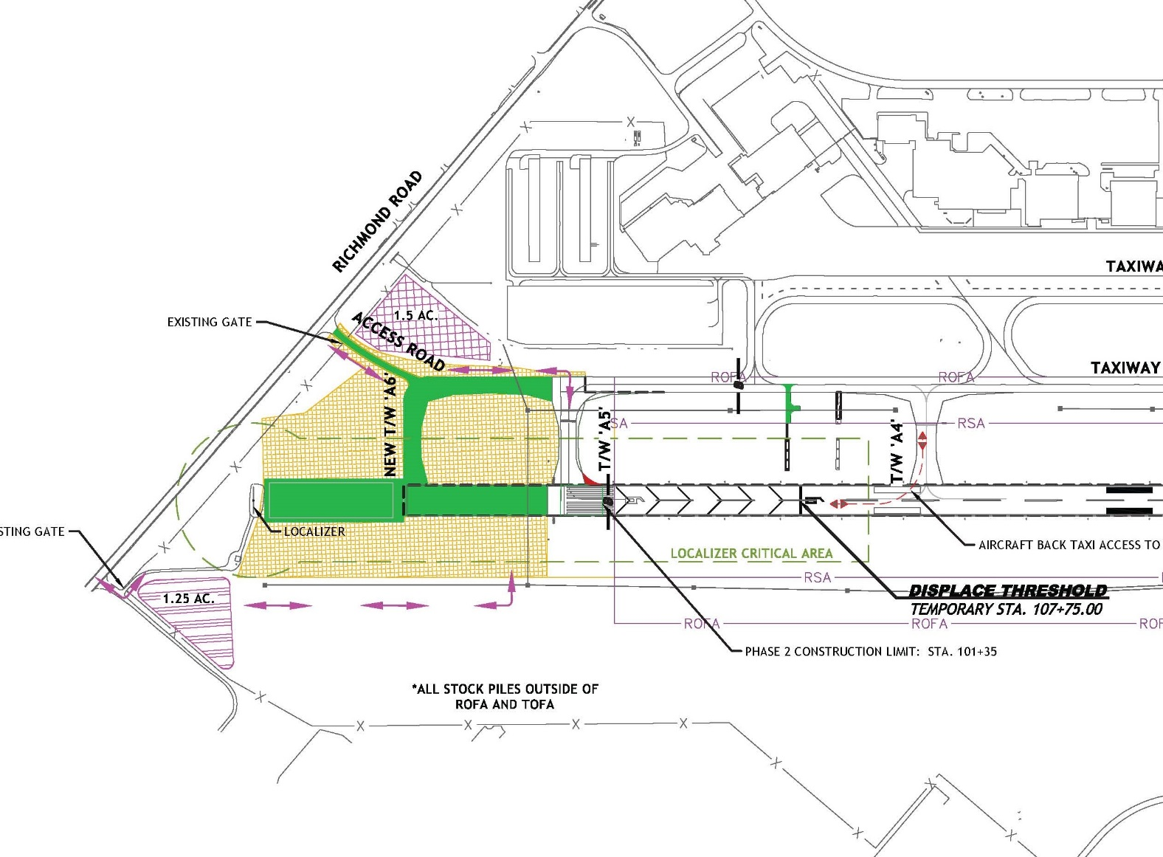
Project #3 – Runway 6 End Extension & EMAS

Slide 11
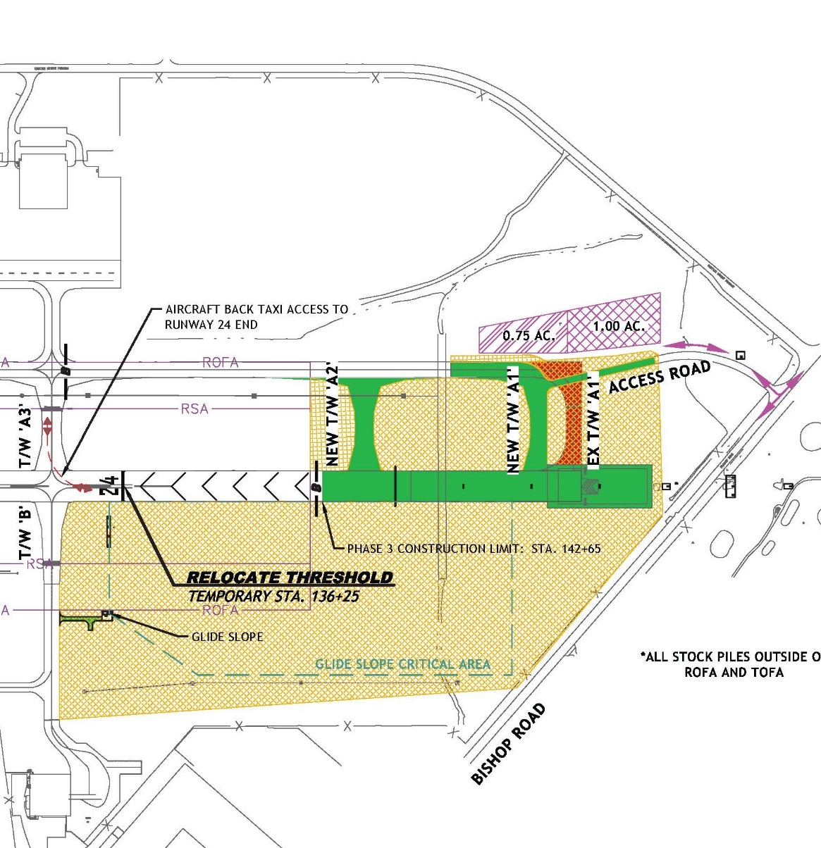
Project #4 – Runway 24 End Relocation & EMAS

Slide 12
Project Completion
Compliant RSA
Pavement Section // 20-year design life
Complaint ROFA and Part 77 Primary Surface
Standard runway transverse grades
Compliant taxiway connector locations
Final Declared Distances
5,502’
Runway 24 LDA – 5,000’
Runway 6 LDA – 5,184’

