Slide 1
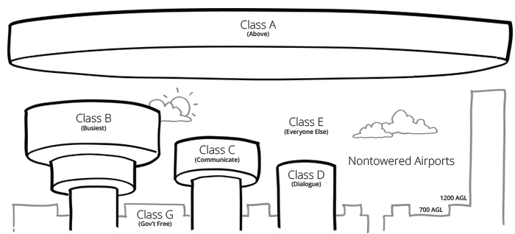
Frequently Used Information
Cuyahoga County Airport (CGF)
T&G Office Location
26300 Curtiss Wright Pkwy, Area B
Richmond Heights, OH 44143
(216) 289-5094
Frequencies
Tower 118.5 ILS 111.1
Ground 121.85 NDB 521
Phone Numbers
CGF Operations: (216) 289-4111
Fuel - Cleveland Jet Center: (216) 261-8800
Runway Information
6-24: 5101 x 100
Surface: Asphalt
Elevation: 879 ft
Internet (both airports):
Network Password: tandgguest
Email: admin@tandgflying.com
Burke Lakefront Airport (BKL)
T&G Office Location
1501 N. Marginal Road, Suite 184
Cleveland, OH 44114
(216) 241-2321
Frequencies
ATIS 125.25 Fuel 129.7
Tower 124.3 ILS 109.75
Ground 121.9 Appr. 125.35
Phone Numbers
BKL Operations: (216) 781-6411
Fuel – Landmark/Signature: (216) 861-2030
BKL Tower: (216) 241-2515
BKL ATIS: (216) 241-6904
Runway Information
6L-24R: 6198 x 150
6R-24L: 5200 x 100
Surface: Asphalt
Elevation: 584 ft
Notes:
Common info plus airspace map.

